Slide 1



Slide 2
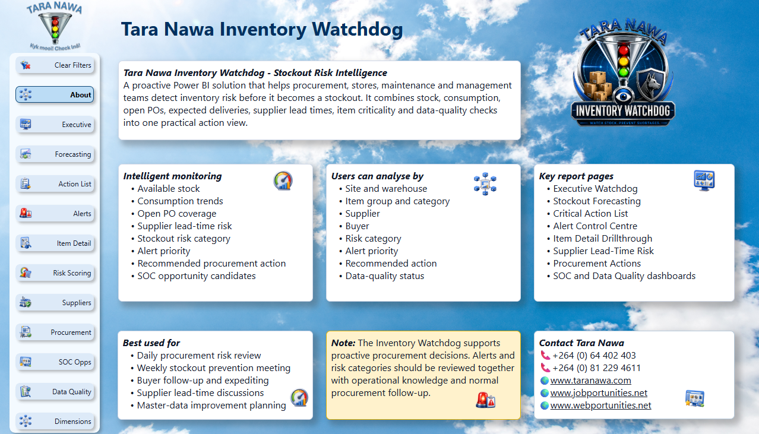
Tara Nawa Inventory Watchdog
Introduction
01
Inventory Risk Intelligence
For Mining, Heavy Industry, Procurement, Stores and Operations
Unique Intelligence Layer
Now includes variability and predictability insight using standard deviation and coefficient of variation.
When averages hide danger, the Watchdog warns you.
Calculations
Beyond ERP Alerts. Beyond Averages. Into Inventory Risk Intelligence.
Traditional ERP systems can show stock levels and reorder warnings.
The Inventory Watchdog explains the risk behind the numbers — detecting unstable consumption, unpredictable supplier lead times, delivery gaps, low-confidence forecasts and hidden stockout exposure.
It does not only tell you what stock you have. It tells you what can go wrong, why it matters, and what procurement should do next.
Check the last 2 slides for examples of using:
Standard Deviation
Coefficient of Variation

Slide 3
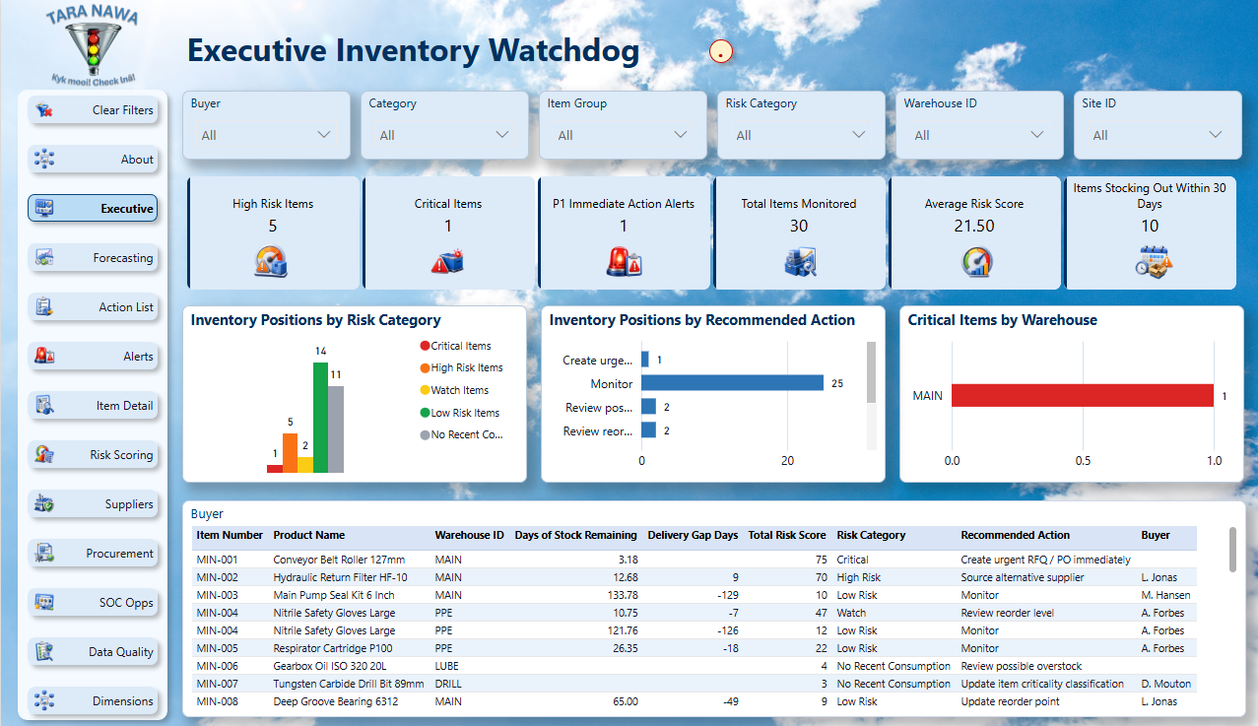
Tara Nawa Inventory Watchdog
The Client Problem
02
Stockouts are rarely sudden, they usually leave a trail
The problem is that the warning signs are often scattered across inventory, procurement, supplier and master-data records.
Hidden risk
Stock can look safe today while consumption is accelerating.
False comfort
An open PO does not help if delivery arrives after the stockout date.
Manual pressure
Buyers depend on local knowledge and follow-up spreadsheets.
Operational impact
Maintenance and production feel the pain before the data tells the full story.
Hidden Risk
Stockouts often begin long before the shelf is empty — the Watchdog helps expose the warning signs earlier.

Slide 4
Tara Nawa Inventory Watchdog
Executive Control Tower
03
Leadership sees where stockout risk is concentrated
The Executive page gives managers a fast view of critical items, high-risk items, P1 alerts and short-cover exposure.
One view
Current risk position across monitored inventory.
Management focus
Warehouses, categories and buyers needing attention.
Drillable proof
Move from KPI cards into the records behind the totals.
Management Visibility
Executives get a clear view of inventory risk, priority areas and operational exposure.

Slide 5
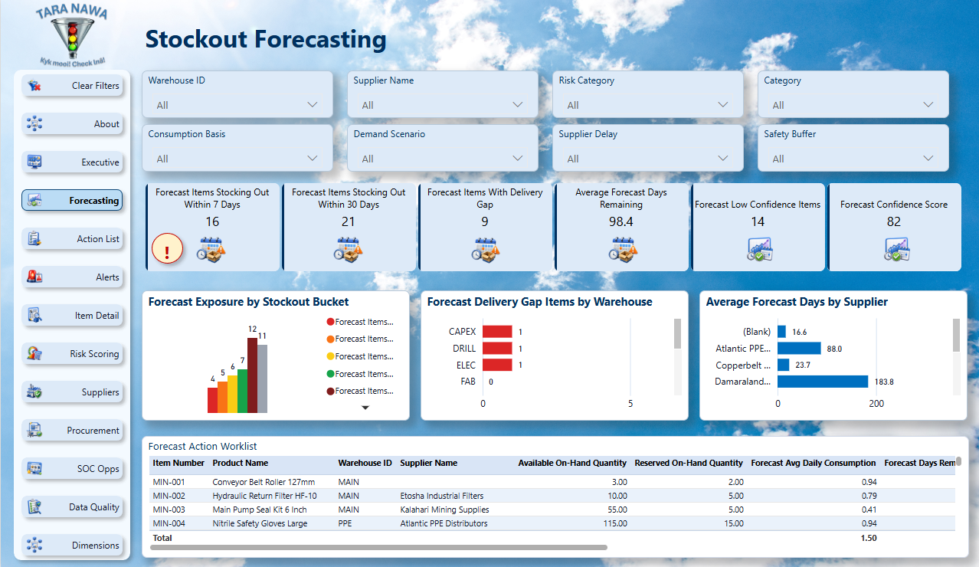
Tara Nawa Inventory Watchdog
What Inventory Watchdog Does
04
It does not just report stock, it interprets risk
The Watchdog combines current stock, usage, open purchase orders, expected delivery, supplier lead time, criticality and data-quality signals.
Detect
Identify items moving toward stockout before operations are disrupted.
Prioritise
Separate P1 immediate action from watch items and information-only alerts.
Explain
Show why a risk score is high and what action is recommended.
Convert
Turn recurring risk into Smart Online Catalogue opportunity.
Early Warning Power
It connects stock, usage, suppliers, purchase orders and risk signals into one clear action view.

Slide 6
Tara Nawa Inventory Watchdog
Stockout Forecasting
05
The question is not only what is available today
Forecasting shows how future exposure changes when demand, supplier delay and safety buffer assumptions change.
Scenario view
Test different consumption and delivery assumptions.
Short-cover focus
Highlight items forecast to run out within 7 or 30 days.
Decision support
Use the result to prioritise expediting, sourcing and safety-stock review.
Before It Breaks
Forecasting helps teams see which items may run out before operations are disrupted.

Slide 7
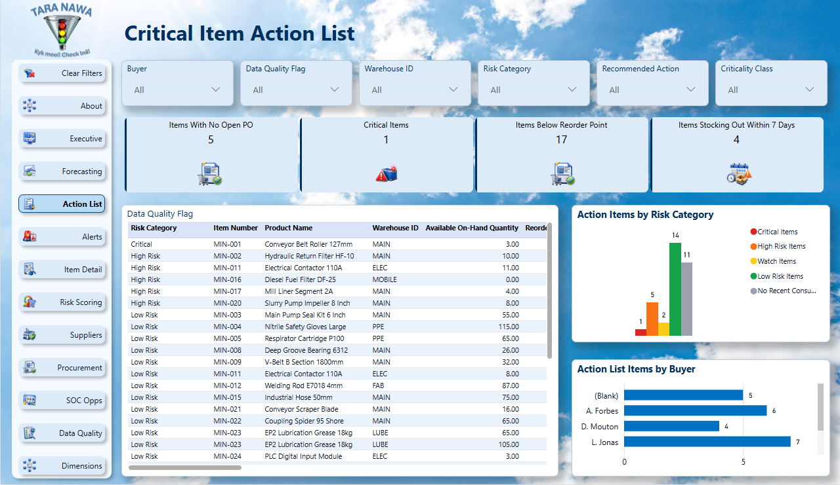
Tara Nawa Inventory Watchdog
Critical Item Action List
06
The buyer gets a daily worklist, not just another dashboard
Critical and high-risk items are listed with stock cover, delivery gap, supplier, buyer and recommended action.
Prioritised work
Start with Critical and High Risk items.
Export-friendly
Give buyers a working list they can act on.
Accountability
Link item, warehouse, buyer, supplier and action.
Action First
The Watchdog turns risk into a practical worklist so teams know what to act on first.

Slide 8
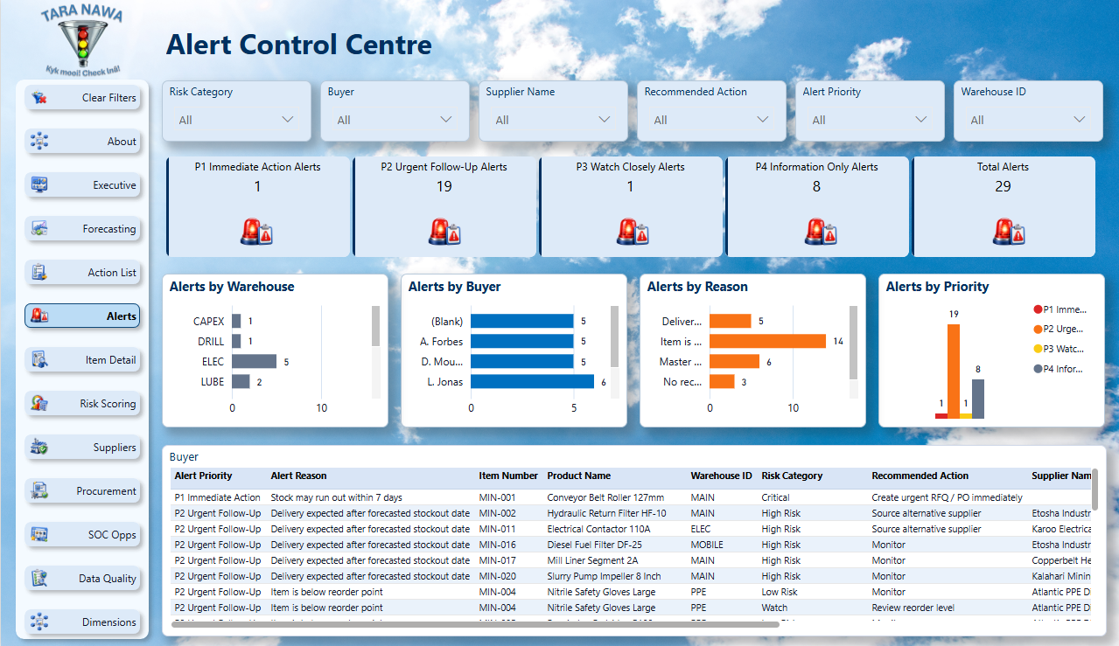
Tara Nawa Inventory Watchdog
Alert Control Centre
07
Too many alerts become noise - The Watchdog separates urgency
P1 alerts are reviewed first, followed by P2 urgent follow-up, P3 watch closely and P4 information only.
P1 focus
Immediate action where the risk is most urgent.
Buyer routing
Alerts filter by buyer, supplier, warehouse and risk category.
Practical follow-up
Alert detail tables support daily procurement discipline.
Accountability
Alerts help assign focus, urgency and responsibility before small issues become major disruptions.

Slide 9
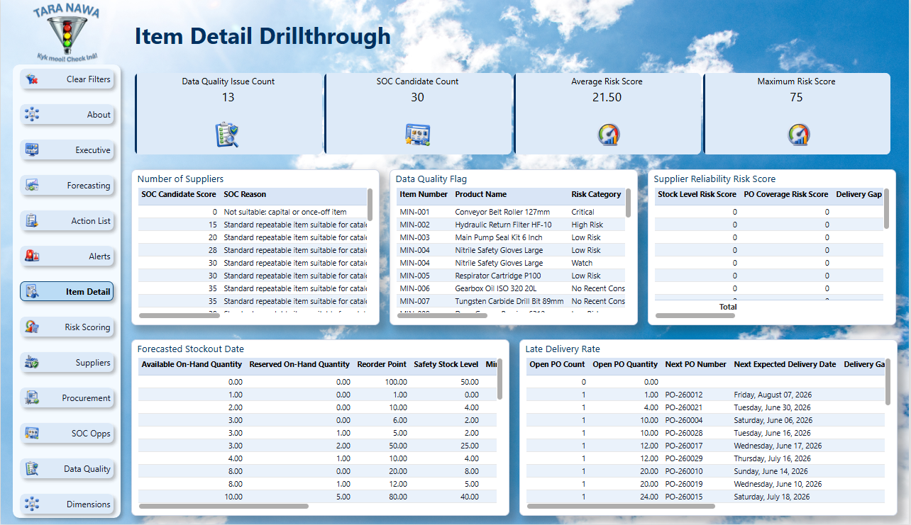
Tara Nawa Inventory Watchdog
Item Detail Drillthrough
08
Every risk must be explainable at item level
The drillthrough page shows the evidence behind one item: stock, PO cover, supplier risk, risk components, data quality and SOC details.
Why is it risky?
Shows the score components and stock position.
Will delivery arrive in time?
Compares expected delivery with forecasted stockout.
What must be done?
Displays recommended procurement or data action.
One Item, Full Story
Users can drill into a single item to understand stock, demand, suppliers, risk and recommended action.

Slide 10
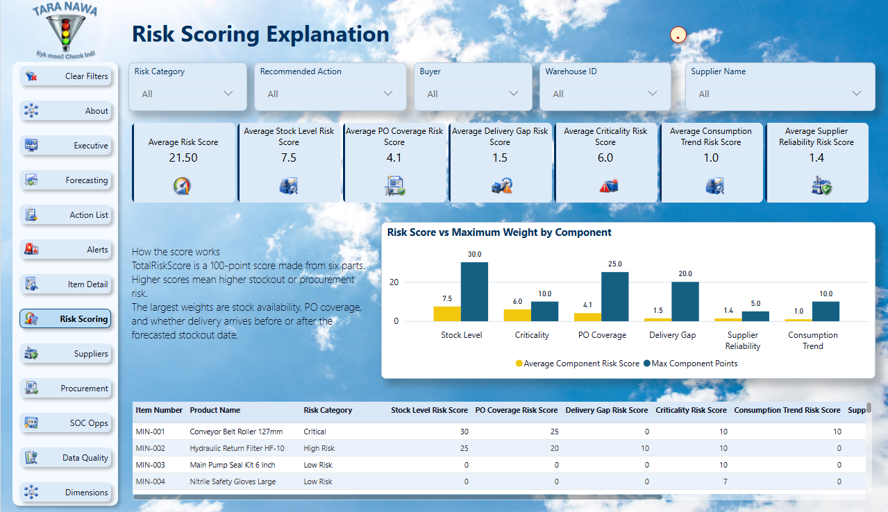
Tara Nawa Inventory Watchdog
Explainable Risk Scoring
09
A score is only useful when users can trust the reason behind it
The model breaks risk into stock level, PO coverage, delivery gap, criticality, consumption movement and supplier reliability.
Six drivers
Users can see what is creating the risk.
Actionable categories
Critical, High Risk, Watch, Low Risk and No Recent Consumption.
Evidence-led decisions
Managers can challenge or confirm the risk using item-level detail.
Risk Made Visible
The Watchdog does not only show that an item is risky — it helps explain why it is risky.

Slide 11
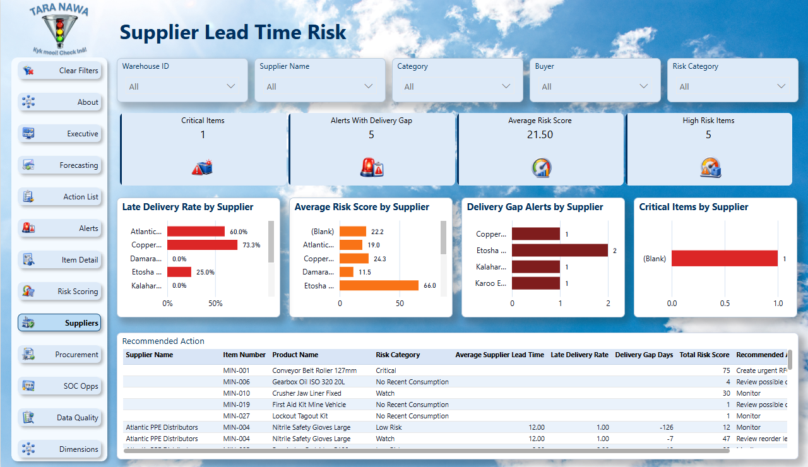
Tara Nawa Inventory Watchdog
Supplier Lead-Time Risk
10
Supplier risk is not only price. It is timing and reliability
The Supplier page exposes late delivery behaviour, lead-time risk, delivery gaps and supplier-linked critical items.
Supplier conversations
Support expediting, renegotiation and alternative sourcing.
Delivery gaps
Show where replenishment may arrive too late.
SupplierKey filtering
Consistent supplier filtering across Watchdog and Alerts.
Supplier Reliability
The Watchdog highlights suppliers and items where delivery timing may create hidden stockout exposure.

Slide 12
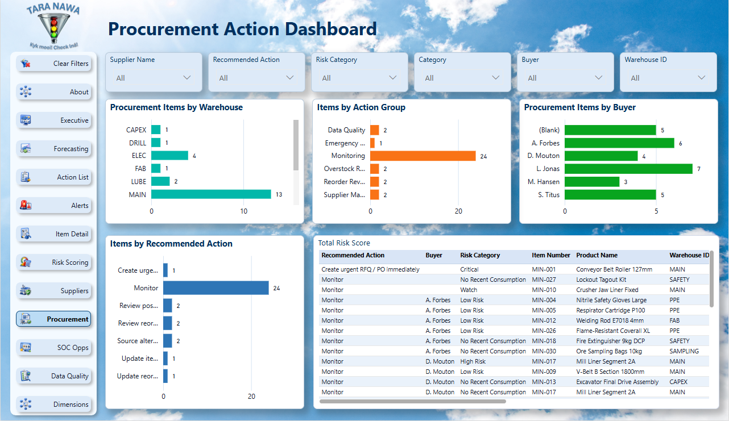
Tara Nawa Inventory Watchdog
Procurement Action Dashboard
11
A command centre for procurement execution
The dashboard groups work by action, buyer, warehouse and supplier so managers can see what must be done now.
Create RFQ or PO
Start procurement where coverage is missing.
Expedite open PO
Follow up where delivery arrives too late.
Source alternatives
Act where supplier reliability creates risk.
Update master data
Correct the weak data that reduces confidence.
Smarter Procurement
Procurement teams can prioritise the right items, follow up earlier and reduce emergency buying.

Slide 13
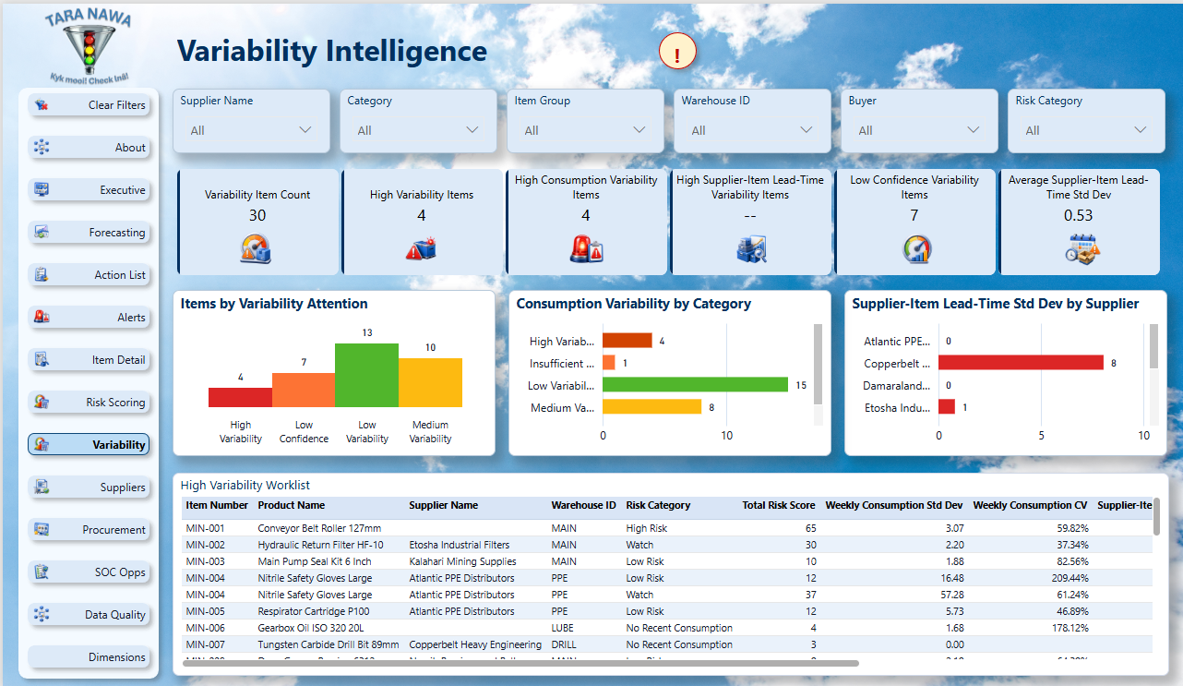
Tara Nawa Inventory Watchdog
Variability Intelligence
12
Averages can be dangerous when the pattern is unstable
The Variability page adds a predictability layer using standard deviation and coefficient of variation for consumption and lead-time behaviour.
Consumption stability
Identify items where usage is irregular and simple averages may mislead.
Lead-time stability
Spot suppliers or supplier-item combinations with unpredictable delivery times.
Low confidence
Flag items where history is too limited for strong conclusions.
Better review
Support reorder, safety-stock, supplier and data-history discussions.
Calculations
Check the last 2 slides for examples of using:
Standard Deviation
Coefficient of Variation
Trust the Pattern
The Watchdog checks whether averages can be trusted by detecting unstable usage and unpredictable supplier lead times.

Slide 14
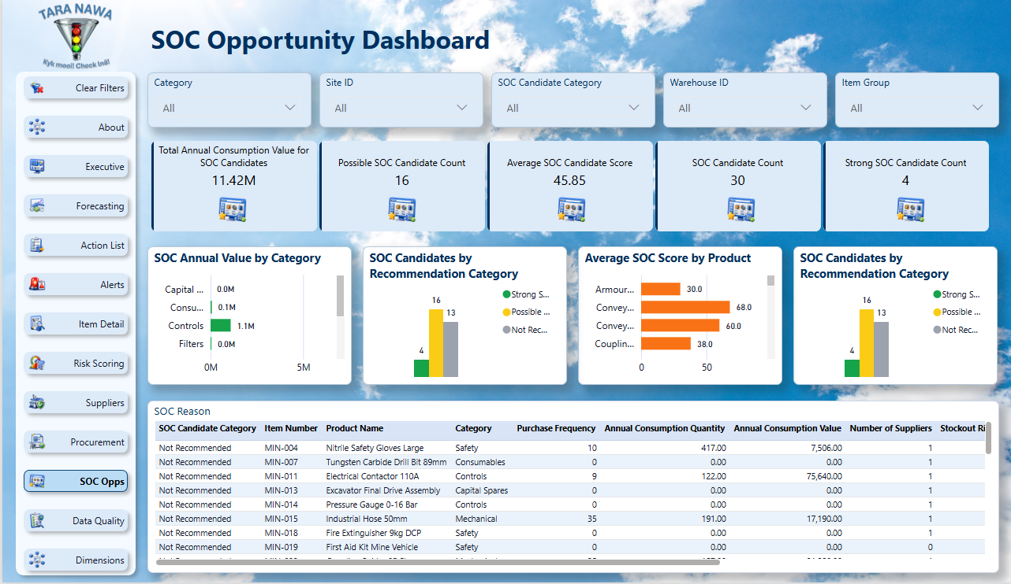
Tara Nawa Inventory Watchdog
SOC Opportunity Dashboard
13
Recurring risk becomes catalogue opportunity
The Watchdog identifies repeatable, high-value, high-risk items that may be suitable for Tara Nawa’s Smart Online Catalogue.
Strong candidates
Find items suitable for catalogue pricing and supplier visibility.
Reduce RFQ pressure
Move repetitive buying into a smarter commercial channel.
Commercial bridge
Watchdog finds the risk. SOC helps solve the recurring procurement problem.
Market Intelligence
The Watchdog helps identify items that may benefit from broader supplier discovery through the Smart Online Catalogue.

Slide 15
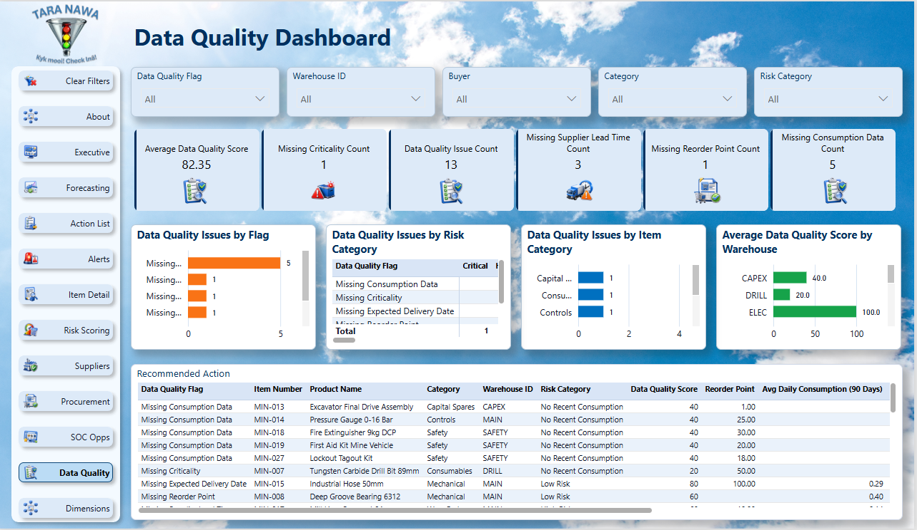
Tara Nawa Inventory Watchdog
Data Quality Dashboard
14
Bad data creates false confidence
The Data Quality page identifies missing or weak consumption, reorder, criticality, lead-time and expected-delivery data.
Confidence layer
Separate stockout risk from data completeness.
Cleanup worklist
Give data owners a practical improvement list.
Better predictions
Improve the future reliability of the Watchdog model.
Better Data, Better Decisions
Weak or incomplete data can create weak decisions — the Watchdog highlights where data needs attention.

Slide 16
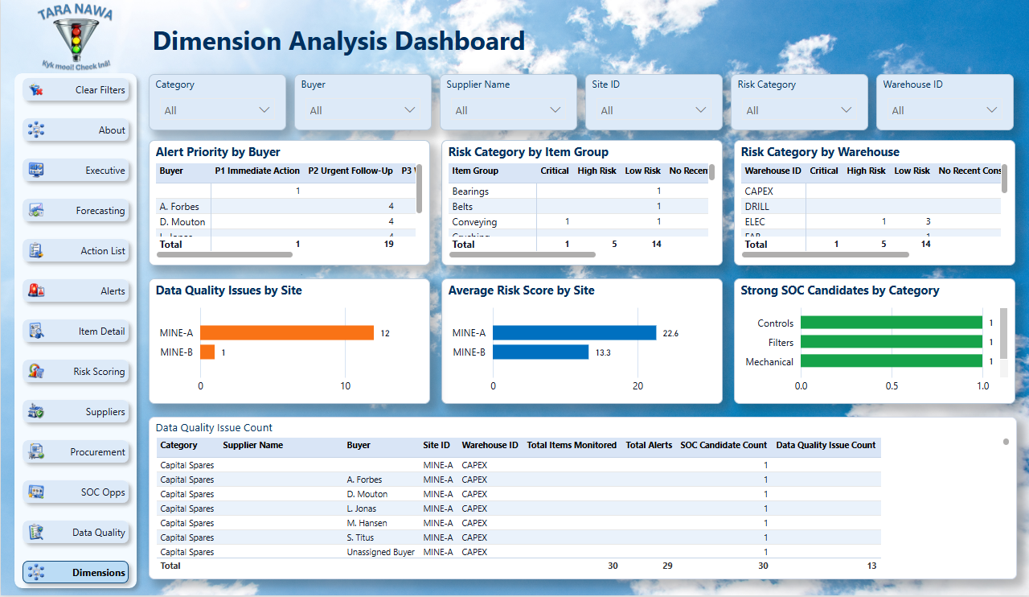
Tara Nawa Inventory Watchdog
Dimensional Procurement Intelligence
15
Risk can be analysed by item, supplier, buyer, site and warehouse
The Dimension Analysis page gives managers a broader view of where inventory risk, alerts, SOC opportunity and data quality issues are concentrated.
Cross-dimensional view
Analyse risk by site, warehouse, item group, supplier and buyer.
Management insight
Identify concentration patterns and recurring exposure.
Scalable model
Built on separate dimensions for client-ready deployment.
Deeper Insight
Risk can be analysed by site, warehouse, buyer, supplier, item group and category to find where attention is needed.

Slide 17
Tara Nawa Inventory Watchdog
Implementation Path
16
Start small, Prove value, Then automate
A practical route from sample data to production deployment.
1. Sample extract
Client provides inventory, consumption, PO, supplier and item data.
2. Load and validate
Data is loaded into SQL views and checked for completeness.
3. Power BI demo
The Watchdog reveals the client’s own risk profile.
4. Production roadmap
Agree refresh, security, alerts, notifications and SOC integration.
Fast Practical Start
The Watchdog can start with existing inventory and procurement data, then improve as data quality and history grow.

Slide 18
Tara Nawa Inventory Watchdog
Recommended Client Conversation
17
The best demo uses the client’s own data
A sample extract is enough to show where the first risks, suppliers, buyers, warehouses and catalogue opportunities are hiding.
Open with risk
Which items could interrupt operations before anyone sees it?
Show proof
Executive page, action list, alerts, forecasting, variability and item detail.
Close with action
Request a sample data pack and run the first client-specific Watchdog review.
Start the Discussion - Watch Carefully, Act Early
The key question is not only what stock you have — it is what risk is already building beneath the surface.
The most expensive stockout is usually the one that could have been seen coming.

Slide 19

Why averages can be misleading
18
The Watchdog checks whether the average can be trusted
A normal stock report often uses average consumption or average supplier lead time. But averages can hide instability. Two items may have the same average, yet one may be steady and predictable while the other may be erratic and risky.
The Watchdog therefore checks standard deviation and coefficient of variation (CV).
Key formulas
Standard deviation: σ = √[ Σ(xᵢ − x̄)² / n ]
Coefficient of variation: CV = (Standard Deviation ÷ Average) × 100%
In simple terms: standard deviation measures how much values jump around, while CV shows how big that instability is compared to the average.
Example 1 – Consumption
Item A – Stable usage
Weekly usage: 10, 10, 9, 11, 10
Average = 10
Standard deviation ≈ 0.7
CV ≈ (0.7 ÷ 10) × 100% = 7%
Meaning: usage is steady, so planning is more reliable.
Item B – Unstable usage
Weekly usage: 0, 2, 35, 0, 13
Average = 10
Standard deviation ≈ 14.7
CV ≈ (14.7 ÷ 10) × 100% = 147%
Meaning: the average looks the same, but the pattern is highly unstable. This item is harder to plan for and may create hidden stockout risk.
Example 2 – Supplier lead time
Supplier A – Predictable delivery
Delivery days: 10, 11, 10, 9, 10
Average = 10 days
Standard deviation ≈ 0.7
CV ≈ (0.7 ÷ 10) × 100% = 7%
Meaning: this supplier is reliable and easier to plan around.
Supplier B – Unpredictable delivery
Delivery days: 5, 28, 12, 40, 8
Average = 18.6 days
Standard deviation ≈ 14.9
CV ≈ (14.9 ÷ 18.6) × 100% ≈ 80%
Meaning: delivery timing jumps around, so the average alone cannot be trusted.
False Confidence Warning
Two items can have the same average, but very different risk — the Watchdog reveals the difference.

Slide 20
How the coefficient of variation helps decisions
19
From calculation to practical action
Coefficient of variation (CV) shows how unpredictable a pattern is compared to its average. It tells the Watchdog whether a normal average is reliable enough to use for planning decisions.
Low CV = more predictable. High CV = less predictable and more caution is needed.
Practical decision guide
How the Watchdog uses CV
CV 0% – 25%
Stable
Average is fairly reliable.
If consumption CV is high, the Watchdog may suggest:
• review reorder levels
• review safety stock
• treat the forecast with caution
• monitor the item more closely
CV 25% – 50%
Moderate variability
Monitor and review if risk is rising.
CV 50% – 100%
High variability
Review reorder logic and planning assumptions.
If supplier lead-time CV is high, the Watchdog may suggest:
• increase safety stock
• expedite orders earlier
• review supplier reliability
• consider alternative suppliers
CV above 100%
Very unstable
Treat the average with caution. Use stronger controls.
Decision Intelligence
The Watchdog does not only ask “What is the average?” It also asks “Can we trust the average enough to make a safe decision?”
This helps identify unstable consumption, unpredictable supplier lead times, low-confidence planning assumptions, and hidden stockout risk.

